Slide 1
Design Presentation: Security
Owner:
CS | 1 of 2
Session Day/Time: |  | Presenters/SMEs:
Virtual Format and Software:
Cohort / Breakout Mgmt
Objective of Session: | As a result of attending this, attendees will better be able to…
Existing Sources: | <link to any supporting content sources (if any)>
Learner Content: | <Link to draft ppt slide deck and any other materials that the attendees would be seeing or using as part of this session>
Presenter/ SME Guide Content: | <Link to any supporting materials that are just for the presenter and/or supporting SMEs>
Required Homework + name of session for HW review: | No homework or pre-required content needed for this session

Slide 2
Design Presentation: Security
Owner: Sean Norman
CSA07P | 2 of 2
Session Flow and Detailed Agenda |  | Presenter/SME: | Time
Prework | No attendee pre-work needed for this session | N/A | N/A
Session Introduction | Set context for when this process takes place | <presenter> | 3 mins
Body of the session / discussion, activities, Q&A... |  | <presenter> | 25 mins
Session Closing / Homework |  | <presenter> | 2 mins

Slide 3
Topics Covered
Spark and Machine Learning
Teams Data Science Process
Spark
Machine Learning

Slide 4
Spark and Machine Learning in Azure Synapse

Slide 5

Agenda
1 Team Data Science Process
Key components of the TDSP
2 Spark
Apache Spark in Synapse Analytics use cases
3 Machine Learning
Machine Learning in Azure Synapse Analytics

Slide 6
Team Data Science Process

Slide 7
Definition
The Team Data Science Process (TDSP) is an agile, iterative data science methodology to deliver predictive analytics solutions and intelligent applications efficiently.

Slide 8
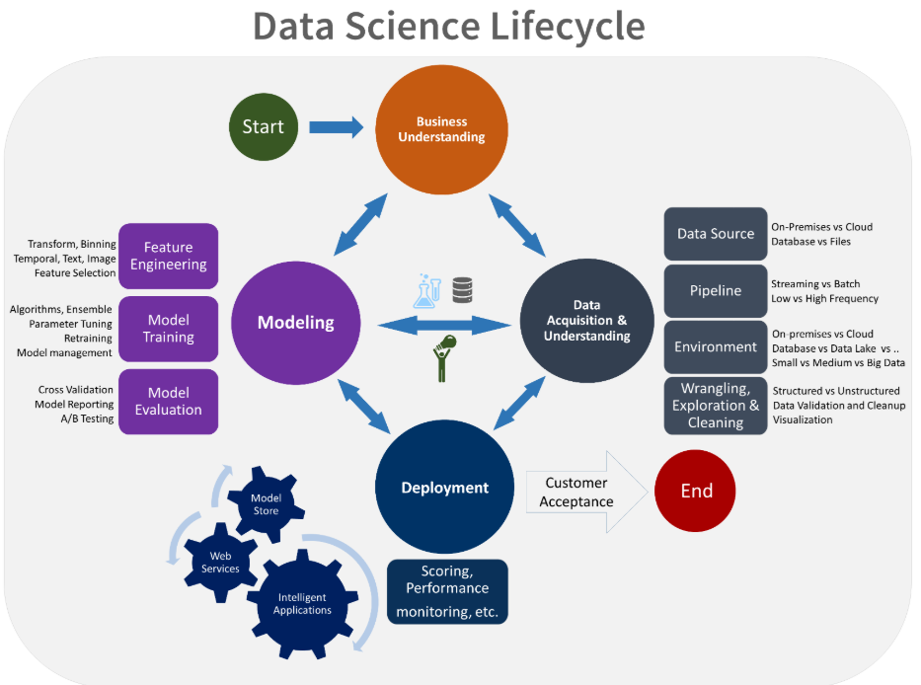

Slide 9
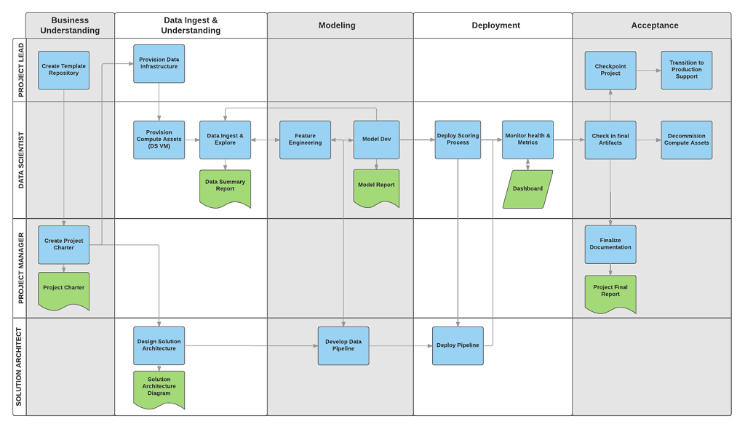
TDSP Roles and Tasks
Notes:
The tasks and artifacts each stage of the lifecycle in TDSP lifecycle are associated with project roles:
Solution architect
Project manager
Data engineer
Data scientist
Application developer
Project lead
The diagram provides a grid view of the tasks (in blue) and artifacts (in green) associated with each stage of the lifecycle (on the horizontal axis) for these roles (on the vertical axis).

Slide 10
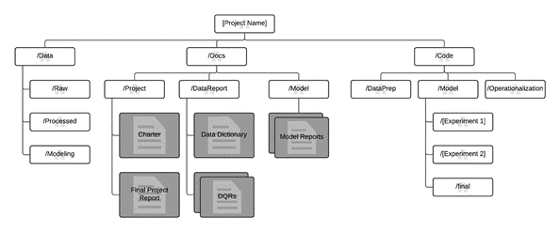
Standardized project structure
Notes:
Templates are provided for the folder structure and required documents in standard locations. This folder structure organizes the files that contain code for data exploration and feature extraction, and that record model iterations. These templates make it easier for team members to understand work done by others and to add new members to teams. It is easy to view and update document templates in markdown format. Use templates to provide checklists with key questions for each project to insure that the problem is well defined and that deliverables meet the quality expected.

Slide 11
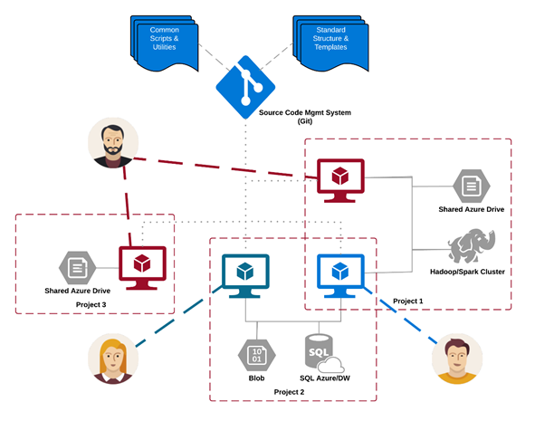
Example of TDSP recommended infrastructure
Notes:
TDSP provides recommendations for managing shared analytics and storage infrastructure such as:
cloud file systems for storing datasets
databases
big data (SQL or Spark) clusters
machine learning service
The analytics and storage infrastructure, where raw and processed datasets are stored, may be in the cloud or on-premises. This infrastructure enables reproducible analysis. It also avoids duplication, which may lead to inconsistencies and unnecessary infrastructure costs. Tools are provided to provision the shared resources, track them, and allow each team member to connect to those resources securely. It is also a good practice to have project members create a consistent compute environment. Different team members can then replicate and validate experiments.

Slide 12
Development
Agile development
Work Item Types
Sprints
Features in the backlog
User stories
Tasks
Collaborative coding with Git
Workitems
Branches
Pull requests
Review and merge

Slide 13
Development
Execute data science tasks
Exploration
Modeling
Deployment
Code testing
Azure DevOps for the testing framework
Flow of code testing
Detailed steps

Slide 14
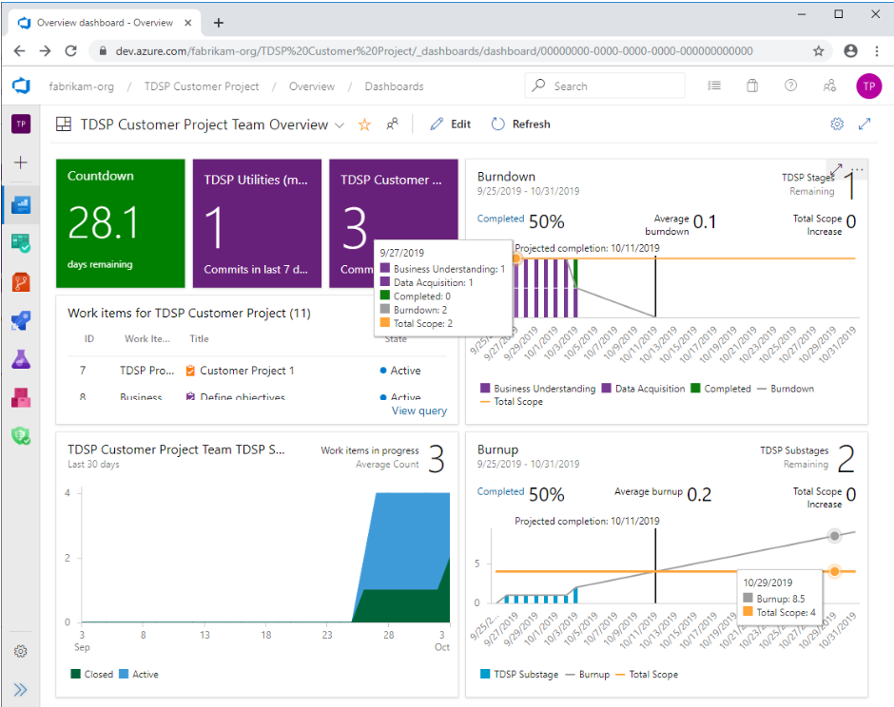
Development
Track progress in Azure DevOps dashboards

Slide 15
Spark in Azure Synapse Analytics

Slide 16
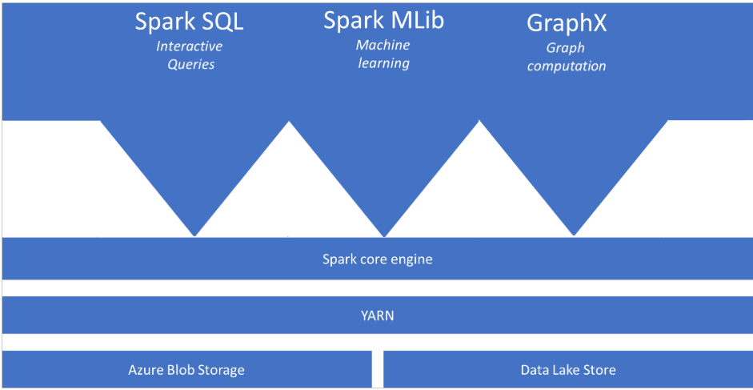
What is Apache Spark in Azure Synapse Analytics

Slide 17
Apache Spark Core Concepts
Boost the performance of big-data analytic applications
Spark pools: when instantiated, is used to create a Spark instance that processes data
Spark instances: created when you connect to a Spark pool, create a session, and run a job
Notes:
Apache Spark is a parallel processing framework that supports in-memory processing to boost the performance of big-data analytic applications

Slide 18


Spark Notebook Execution with the Synapse Job Service
AAD
Synapse Studio
Synapse Service
Gateway
Auth Service
Job Service Frontend
…
Resource Provider
Spark API Controller
DB
Job Service Backend
Azure
Instance Creation Service
Spark Plugin
…
DB
DB
Spark Instance
VM
VM
VM
VM
VM
VM
Notes:
In Synapse Studio, the user attaches Notebook to Spark pool and enters one or more Spark statements (code blocks).
The Notebook client gets user token from AAD and sends a Spark session create request to the Synapse Gateway.
Synapse Gateway authenticates the request and validates authorizations on the Workspace and Spark pool and forwards it to the Spark (Livy) controller hosted in Synapse Job Service frontend.
The Job Service frontend forwards the request to Job Service backend that creates two jobs – one for creating the cluster and the other for creating the Spark session.
The Job service backend contacts Synapse Resource Provider to obtain Workspace and Spark pool details and delegates the cluster creation request to Synapse Instance Creation Service.
Once the Spark Instance is created, the Job Service backend forwards the Spark session creation request to the Livy endpoint in the cluster.
Once the Spark session is created the Notebook client sends Spark statements to the Job Service frontend.
Job Service frontend obtains the actual Livy endpoint for the cluster created for the particular user from the backend and sends the statement directly to Livy for execution.

Slide 19
Synapse Spark Instance Creation
Azure Resource Provider
3
Provision Resources
Spark Instance
2
Create VMs with
Specialized VHD
Subnet
VM – 001
VM – 002
VM – 003
VM – 004
VM – 005
Spark Executors
Spark Executors
Spark Executors
Spark Executors
Hive Metastore
YARN NM - 01
Livy - 01
YARN NM - 02
Zookeeper - 01
Zookeeper - 02
Zookeeper - 03
YARN RM - 01
YARN RM - 02
YARN NM - 03
YARN NM - 04
Node Agent
Node Agent
Node Agent
Node Agent
Node Agent
1
Create Cluster
Synapse Cluster
Service
(Control Plane)
4
Heartbeats
Heartbeat sequence
Notes:
Synapse Job Service sends request to Cluster Service for creating clusters per the description in the associated Spark pool.
Cluster Service sends request to Azure using Azure SDK to create VMs (required plus additional) with specialized VHD.
The specialized VHD contains bits for all the services that are required by the Cluster type (for e.g. Spark) with prefetch instrumentation.
Once VM boots up, the Node Agent sends heartbeat to Cluster Service for getting node configuration.
The nodes are initialized and assigned roles based on their first heartbeat.
Extra nodes get deleted on first heartbeat.
After Cluster Service considers the cluster ready, it returns the Livy end-point to the Job Service.

Slide 20
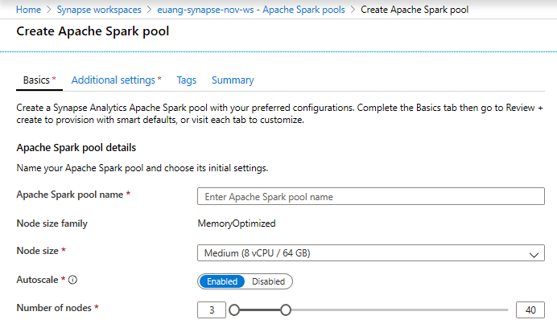
Creating a Spark pool (1 of 2)
Provision Spark Pool through Azure Portal with default settings or per requirements
Basic Settings – Minimum details required from user
Only required field from user
Default Settings

Slide 21
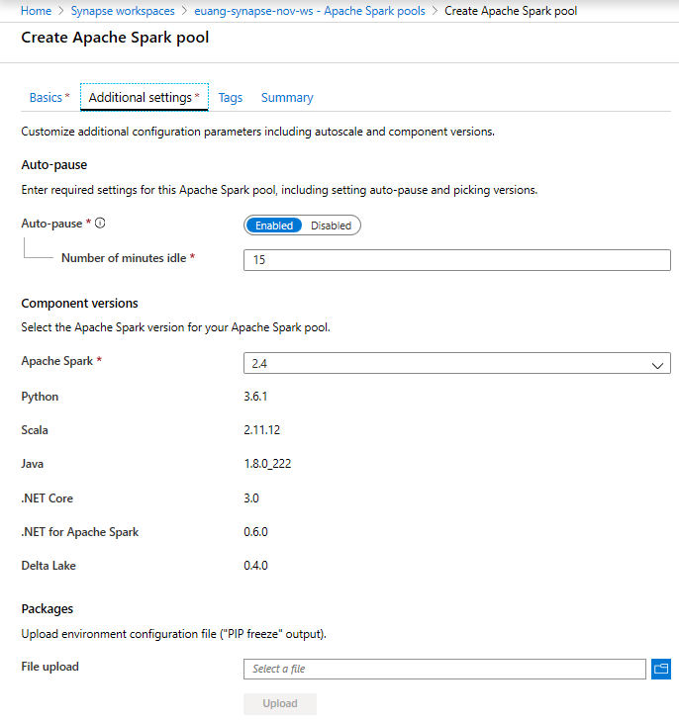
Creating a Spark pool (2 of 2) - optional
Additional Settings offer optional settings to customize Spark pool
Customize component versions, auto-pause
Import libraries by providing text file containing library name and version

Slide 22
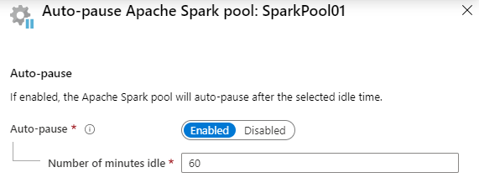
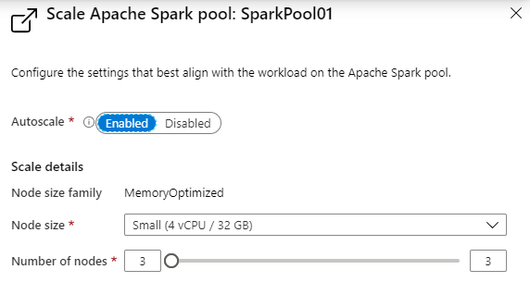
Spark Pools - Configuring
Auto-pause
Enables the pool to automatically stop running when no Spark applications (e.g., Notebooks) are running.
Autoscale
Enables the pool to automatically adjust the number of running nodes (VM’s) supporting the Spark pool.
Note: Just because a pool is running, does not mean all the nodes allowed to run, according to the scale configuration, are actually running. They will be allocated on demand as new Notebooks are executed, up to the limit configured in autoscale.

Slide 23
Runtime language and library support
Spark : Spark 2.4 is the currently supported version.
Operating System : Apache Spark in Azure Synapse runs on Ubuntu version 16.04.
Java : Apache Spark in Azure Synapse includes Java version 1.8.0_222
Scala : Apache Spark in Azure Synapse includes Scala 2.11.12
.NET Core : Apache Spark in Azure Synapse includes .NET Core 3.0
.NET Support for Apache Spark: Azure Synapse includes .NET Support for Apache Spark 0.11.0
Delta Lake: Synapse Analytics includes support for Delta Lake 0.6.0
Python: Apache Spark in Azure Synapse includes an installation of Python version 3.6.1
Scala and Java libraries
Notes:
Apache Spark is a parallel processing framework that supports in-memory processing to boost the performance of big-data analytic applications

Slide 24
What is Delta Lake?
Azure Synapse Analytics is compatible with Linux Foundation Delta Lake. Delta Lake is an open-source storage layer that brings ACID (atomicity, consistency, isolation, and durability) transactions to Apache Spark and big data workloads..
Key Features
ACID Transactions
Scalable Metadata Handling
Time Travel (data versioning)
Open Format
Unified Batch and Streaming Source and Sink
Schema Enforcement
Schema Evolution
Audit History
Updates and Deletes
100% Compatible with Apache Spark API

Slide 25
Optimize Apache Spark jobs (preview)
Choose the data abstraction: DataFrames, DataSets,RDDs
Use optimal data format: parquet with snappy compression
Use the cache: .persist(), .chache(), CACHE TABLE
Use the memory efficiently: smaller data partitions, Kryo data serialization, monitor and tune settings
Optimize data serialization: Kryo serialization, Java serialization
Use bucketing
Optimize joins and shuffles
Optimize job execution
Notes:
Earlier Spark versions use RDDs to abstract data, Spark 1.3, and 1.6 introduced DataFrames and DataSets, respectively. Consider the following relative merits:
DataFrames
Best choice in most situations.
Provides query optimization through Catalyst.
Whole-stage code generation.
Direct memory access.
Low garbage collection (GC) overhead.
Not as developer-friendly as DataSets, as there are no compile-time checks or domain object programming.
DataSets
Good in complex ETL pipelines where the performance impact is acceptable.
Not good in aggregations where the performance impact can be considerable.
Provides query optimization through Catalyst.
Developer-friendly by providing domain object programming and compile-time checks.
Adds serialization/deserialization overhead.
High GC overhead.
Breaks whole-stage code generation.
RDDs
You don't need to use RDDs, unless you need to build a new custom RDD.
No query optimization through Catalyst.
No whole-stage code generation.
High GC overhead.
Must use Spark 1.x legacy APIs.

Slide 26
Automatically scale Azure Synapse Analytics Apache Spark pools
Metrics monitoring
Load-based scale conditions
Best practices
Consider the latency of scale up or scale down operations
Preparation for scaling down

Slide 27
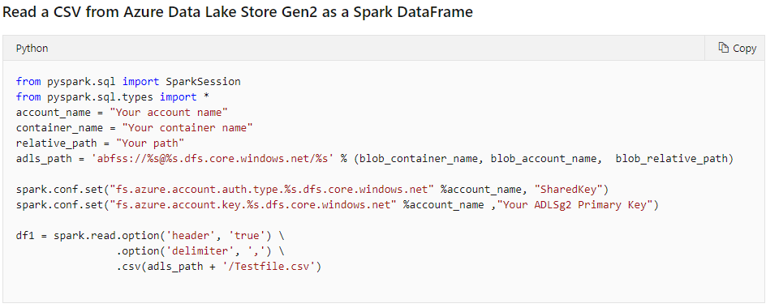
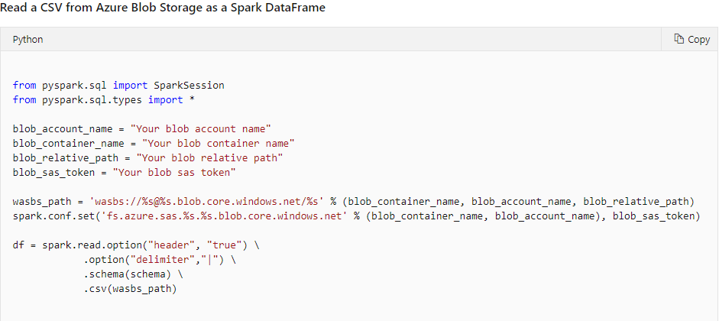
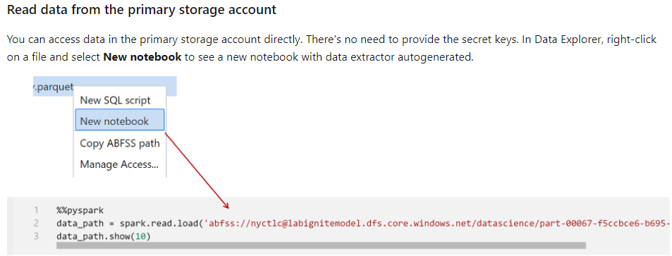
Development: Bring data to a notebook

Slide 28
Development: Bring data to a notebook
SQL Analytics Provider for Spark
Notes:
Spark.read.sqlanalytics

Slide 29
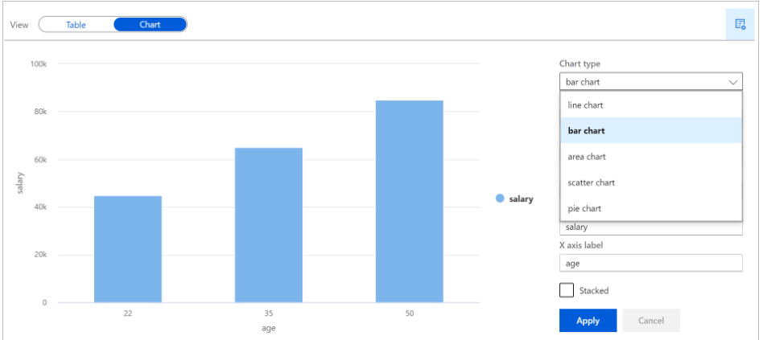
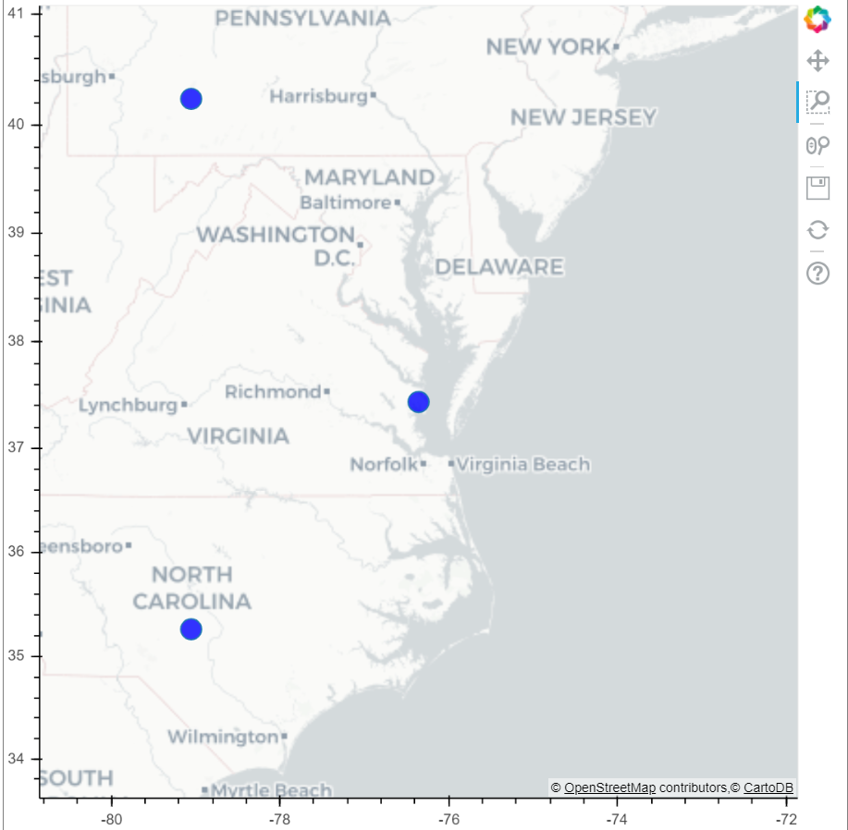
Development: Visualize data in a notebook
DisplayHTML()
Display()

Slide 30
Machine Learning

Slide 31
Machine Learning in Azure Synapse Analytics
Spark Mllib
provides many utilities that are useful for machine learning tasks, including utilities that are suitable for: Classification,Regression,Clustering,Topic modeling,Singular value decomposition (SVD) and principal component analysis (PCA),Hypothesis testing and calculating sample statistics
Azure Machine Learning Integration
support for connecting with Azure Machine Learning SDK to a workspace

Slide 32
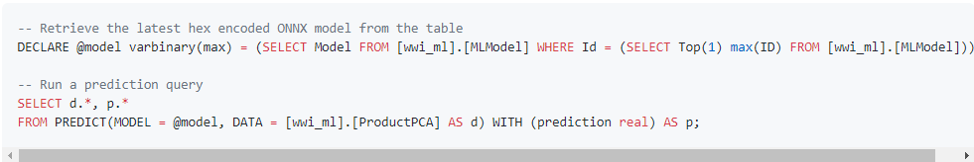
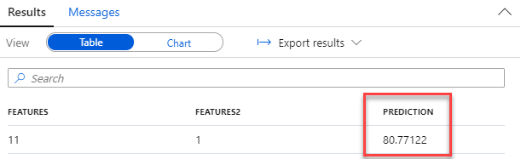
PREDICT function in SQL Pool
Make predictions with a registered model from SQL script

Slide 33
Exploratory data analysis
Notes:
https://github.com/solliancenet/azure-synapse-analytics-workshop-400/blob/master/artifacts/day-03/lab-06-machine-learning/Lab%2006%20-%20Machine%20Learning.ipynb

Slide 34
Using AutoML from Synapse Spark

Slide 35
Deploying models to SQL Pools
Notes:
Lab 06 ex 1

Slide 36
Train a recommender using Spark MLlib

Slide 37
Thank You slide
Thank you

